Slide 1

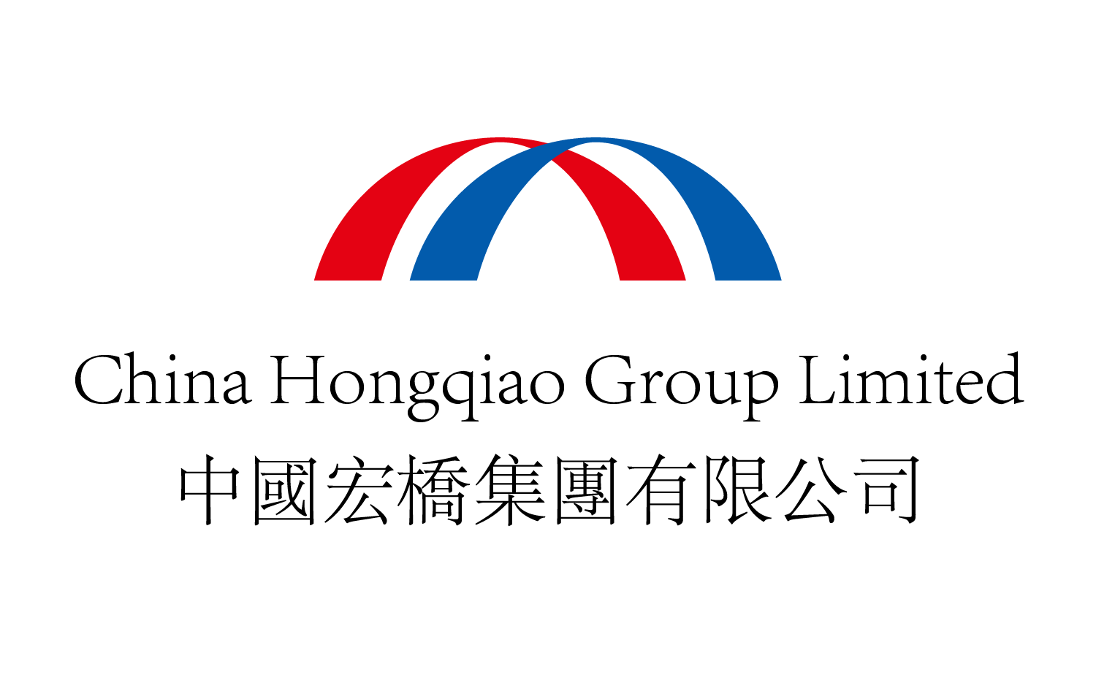
Aluminum in a Changing World – 2025
变幻世界中的铝行业之2025
China Hongqiao Group
中国宏桥集团
Asian Metal
亚洲金属网

Slide 2


Disclaimer
This document has been prepared by China Hongqiao Group Limited (abbreviated as “China Hongqiao” or the “Company”) for the sole purpose of corporate communication and general reference only. The presentation is not intended as an offer to sell, or to solicit an offer to buy any class of securities of the Company in any jurisdiction. This presentation is provided without any warranty or representation of any kind, either expressed or implied. The Company specifically disclaims all responsibilities in respect of any loss, whether financial or otherwise. This presentation contains certain forward-looking statements made based on the Company's financial condition, business performance and industry structure. These statements involve inherent risks and uncertainties. Forward-looking statements involve inherent risks and uncertainties. Certain statements related to the Company, characterized by the words “potential”, “estimated”, “expects”, “anticipates”, “objective”, “intends”, “plans”, “believe”, “estimates”, and other similar expressions, aim to indicate they are considered as “forward-looking statements”. These forward-looking statements represent the Company's beliefs concerning future events instead of a guarantee of future business performance. Readers should be cautioned that a number of factors could cause actual results to differ materially from those in forward-looking statements. Forward-looking statements reflect only the views held by the Company as of the date of publication, and it should not be assumed that they have been reviewed or automatically updated in the light of new information or future events. This document is the property of China Hongqiao Group Limited, and all materials contained in this document are protected by copyright and other intellectual property laws. No one can reproduce or retransmit the materials, in whole or in part, in any manner, without the prior written consent of the Company.

Slide 3
what happened, what’s happening, what’s going to happen?
过去，现在，和将来
Aluminum in a Changing World – 2025 & Beyond
变幻世界中的铝行业之2025及以后
What does it mean for China and China Hongqiao Group
这对中国和中国宏桥集团意味着什么

Slide 4
2025 The World is Changing Faster Than Ever
2025年世界变化比以往任何时候都快
The Global South, now the global economic growth engine
全球南方，现在是全球经济增长的引擎
Artificial Intelligence (AI) booming
人工智能（AI）蓬勃发展
China among global peers . . . for example, DeepSeek
中国在全球同行中……例如，DeepSeek
China R&D and innovation driving competitiveness
中国的研发和创新驱动竞争力

Slide 5
2025 T⁻³ . . . Trade & Trump & Tariffs
2025年的T⁻³ ：特朗普&贸易&关税
The Trump economic disruptions
特朗普扰乱了经济
Tariffs are bad – and increase costs for USA consumers
关税很糟糕——增加了美国消费者的成本
a further disruption to (free) trade
进一步破坏了（自由）贸易
it will take time to evaluate the Trump impact on trade and the global economy
需要时间来评价特朗普对贸易和全球经济的影响

Slide 6
China, a global economic powerhouse
中国，一个全球经济强国
The Economist 18th January 2025: the “Made in China 2025” plan introduced a decade ago with the goal to turn China into a green and innovative “manufacturing power”, one that relied less on labour and Western supply chains, and more on automation and new home-grown technologies.
2025年1月28日的《Economist》杂志：十年前发布了“中国制造2025”计划，目标将中国转型为绿色创新的制造强国，减少对劳动力和西方供应链的依赖，提高自动化和本土技术水平。

Slide 7
China, a global R&D powerhouse
中国，一个全球研发经济强国
The R & D focus – the “Made in China 2025” plan called on manufacturers “to funnel 1.68% of their total revenue into research and development by 2025, up from less than 1%in 2015” this objective was achieved in 2023. 专注于研发——“中国制造2025”计划号召制造业将研发投入从2015年的低于1%，提高到2025年的1.68%。该目标已在2023年达成。
The Economist 18th January2025
2025年1月18日《Economist》杂志

Slide 8
China, a global powerhouse in the new industries . . .
中国，全球强国的新产业……
Electric vehicles (EVs) 2025 plan was 3m sales, but over 12m sales in 2024 – over two-thirds of the global total 电动汽车2025计划的销量为300万辆，但2024年的销量超1200万辆，超全球总量的三分之二
clean energy . . . around 90% of world’s solar panels & 70% of its batteries 清洁能源……全球约90%的太阳能板&70%的电池
China’s biggest drone-maker DJI share of the global market for consumer drones is over 90% 中国最大的无人机大疆占全球消费级无人机市场超90%
The Economist 18th January 2025 2025年1月28日《Economist》杂志

Slide 9
China, 2024 Clean Energy installation
中国，2024年清洁能源安装
New solar energy capacity 277 GW in 2024 (up from 217 GW in 2023)
2024年新增太阳能容量277GW（2023年217GW）
new wind energy capacity 79 GW in 2024 (up from 76 GW in 2023)
2024年新增风能容量79GW（2023年76GW）
goal for pumped-storage hydropower is 400 GW by 2040
抽水蓄能水电的目标是到2040年400GW
Source: Trivium China Net Zero Weekly 24 January 2025
来源：Trivium中国净零周报2025年1月24日

Slide 10
2025 The Bauxite conundrum 2025年的铝土矿难题
The global bauxite supply champion . . . Guinea
全球铝土矿供应冠军——几内亚
no Guinea, no bauxite . . . no bauxite, no alumina/aluminum
没有几内亚，就没有铝土矿……没有铝土矿，就没有氧化铝/电解铝
who else, Australia, anyone else? 还有谁？澳大利亚。还有其他吗？
who’s coming to the party? Free entry if you have 5 Mt+ token to play
还有谁来入局？有每年500万吨的供应就有了入场券
Vietnam and Indonesia, depending on domestic VA policies – and maybe Ghana, Kazakhstan 根据当地增值政策，越南和印度尼西亚，还有也许加纳、哈萨克斯坦

Slide 11
2025 Alumina started the year at record price levels
2025年氧化铝以创纪录的价格水平开始了新的一年
China’s alumina capacity around 103 Mt (end Nov 2024)
中国的氧化铝产能约1亿300万吨（截至2024年11月）
China (annualized) production rate around 89 Mt (end Nov 2024)
中国（每年）产量约8900万吨（截至2024年11月）
Indonesia growing alumina capacity/production
印度尼西亚增长的氧化铝产能/产量
who else wants to grow into the global supply market? Guinea?
还有谁想要加入全球供应市场？几内亚？

Slide 12
2025 Primary Aluminum Outlook 2025年原铝展望
China closing in on the 45 Mt production cap
中国越来越接近4500万吨产能天花板
global demand seen by most analysts to be continuing on an upward trajectory
大多数分析师认为全球需求将继续呈上升趋势
who, where, when?
谁，哪里，什么时候？
is this going to unlock or open alternative doors?
会解锁或打开另一扇大门吗？

Slide 13
2025 Recycled Aluminum 2025年的再生铝
Already recycled aluminum is a significant contributor to global market supply
再生铝已经是全球市场供应的重要部分
China produced over 10 Mt recycled aluminum in 2024
中国在2024年生产了超过1000万吨再生铝
this will continue to grow as scrap supply becomes available – and recovery rates improve further
随着废铝供应和回收率的进一步增长而增长
R&D and innovation will see increased market applications
研发和创新会带来新的市场应用

Slide 14
2025 Aluminum Market Changes 2025年铝业市场变化
B + C demand declines in relative importance, especially in China
建筑行业需求的相对重要性下降，特别是在中国
packaging continues to grow
包装继续增长
new demand growth areas keep getting stronger, in support of shifting global priorities in vehicles (NEVs), energy (renewables, PV and wind, UHV-grids & micro-grids, batteries)
新的需求增长领域继续增强，支撑了新能源汽车和能源（可再生、光伏、风能、特高压&微型电网、电池）在全球的优先级

Slide 15
2025 the Energy and Aluminum Dance Partners
2025年能源是电解铝的舞伴
Low carbon electricity – everyone wants it, everyone needs it
低碳电力——每个人都想要，每个人都需要
others to out-bid aluminum smelters on price, if a supply gap for clean electricity 如果有绿电供应缺口，其他行业可在开价上战胜电解铝厂
a need to protect access to available clean, affordable electricity
需要保护绿色的、可负担的电力来源
in-house renewables, behind the meter – DIY electricity supply
电表后端的自建再生能源——DIY电力供应
PV and wind energy now the low-cost options
光伏和风能是目前的低成本选项

Slide 16
2025 Low and Lower Carbon Aluminum
2025年的低碳和更低碳铝
Supply is growing rapidly 供应在快速增长
zero-carbon aluminum still a long way from commercial
零碳铝到商业化还有很长的距离
zero-carbon anode technology still elusive 零碳阳极技术依然难以实现
addressing removal of “carbon-from-energy” should be the short-term focus for both alumina and aluminum
解决“能源中的碳”问题应该是氧化铝和电解铝的短期焦点
2022 IAI data has energy at 67% of total aluminum sector carbon emissions
2022年国际铝协数据显示能源占电解铝总碳排的67%

Slide 17
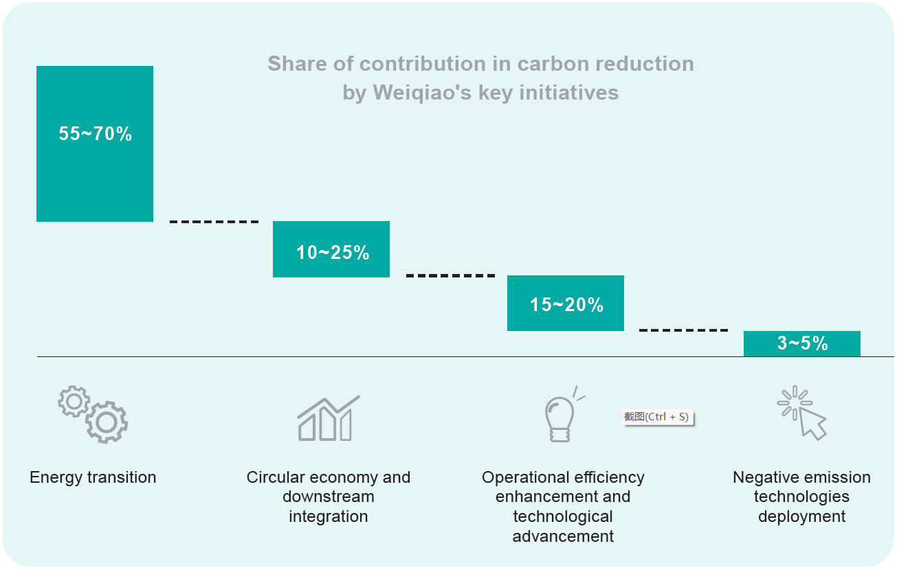
Projected Carbon Reductions from 10 Initiatives
十项举措的预计碳减排

Slide 18
2025 Upgrading Smelter Technology Brings Rewards
2025年升级电解铝技术带来成效
Improved energy efficiency
更高的能效
lower operating costs
更低的运营成本
improved environmental performance
更好的环境表现

Slide 19
China Hongqiao Leading on Aluminum Energy Efficiency中国宏桥的铝能效领先
Regional Data Source: International Aluminium Institute 数据来源：国际铝协

Slide 20
Weiqiao commitment to Green Energy, from
“coal-fired aluminum” to “low-carbon aluminum”
魏桥致力于绿色能源，从“燃煤铝”到“低碳铝”
To continuously increase proportion of green energy, through investment in carbon reduction projects and multiple energy sources, and carrying out cutting-edge technology applications such as new energy storage
通过投资减碳项目和多种能源，开展新能源储能的前沿技术应用，不断提高绿色能源的比重
build an advanced green high-end aluminum manufacturing cluster in Yunnan, a “zero carbon” industrial park, enhancing core competitiveness
在云南打造先进、绿色的高端铝业制造基地，零碳工业园，提升核心竞争力

Slide 21
Weiqiao Pioneering Group New Energy Roadmap
魏桥创业集团的新能源路线图
Recognizes the need for the transformation of our energy structure to achieve our Dual Carbon goals and sustainable development
需要转变我们的能源结构，以实现我们的双碳目标和可持续发展
requiring major investments to construct new energy systems for our aluminum business
需要大量投资来为我们的铝业务构建新能源系统
step 1: a 300 MW PV grid-connected project in 2020 utilizing 4.52 million m² roof area of our Binzhou plants
第一步：利用我们滨州厂房452万平方米的屋顶面积，在2020年建设了一个300MW的光伏并网项目

Slide 22
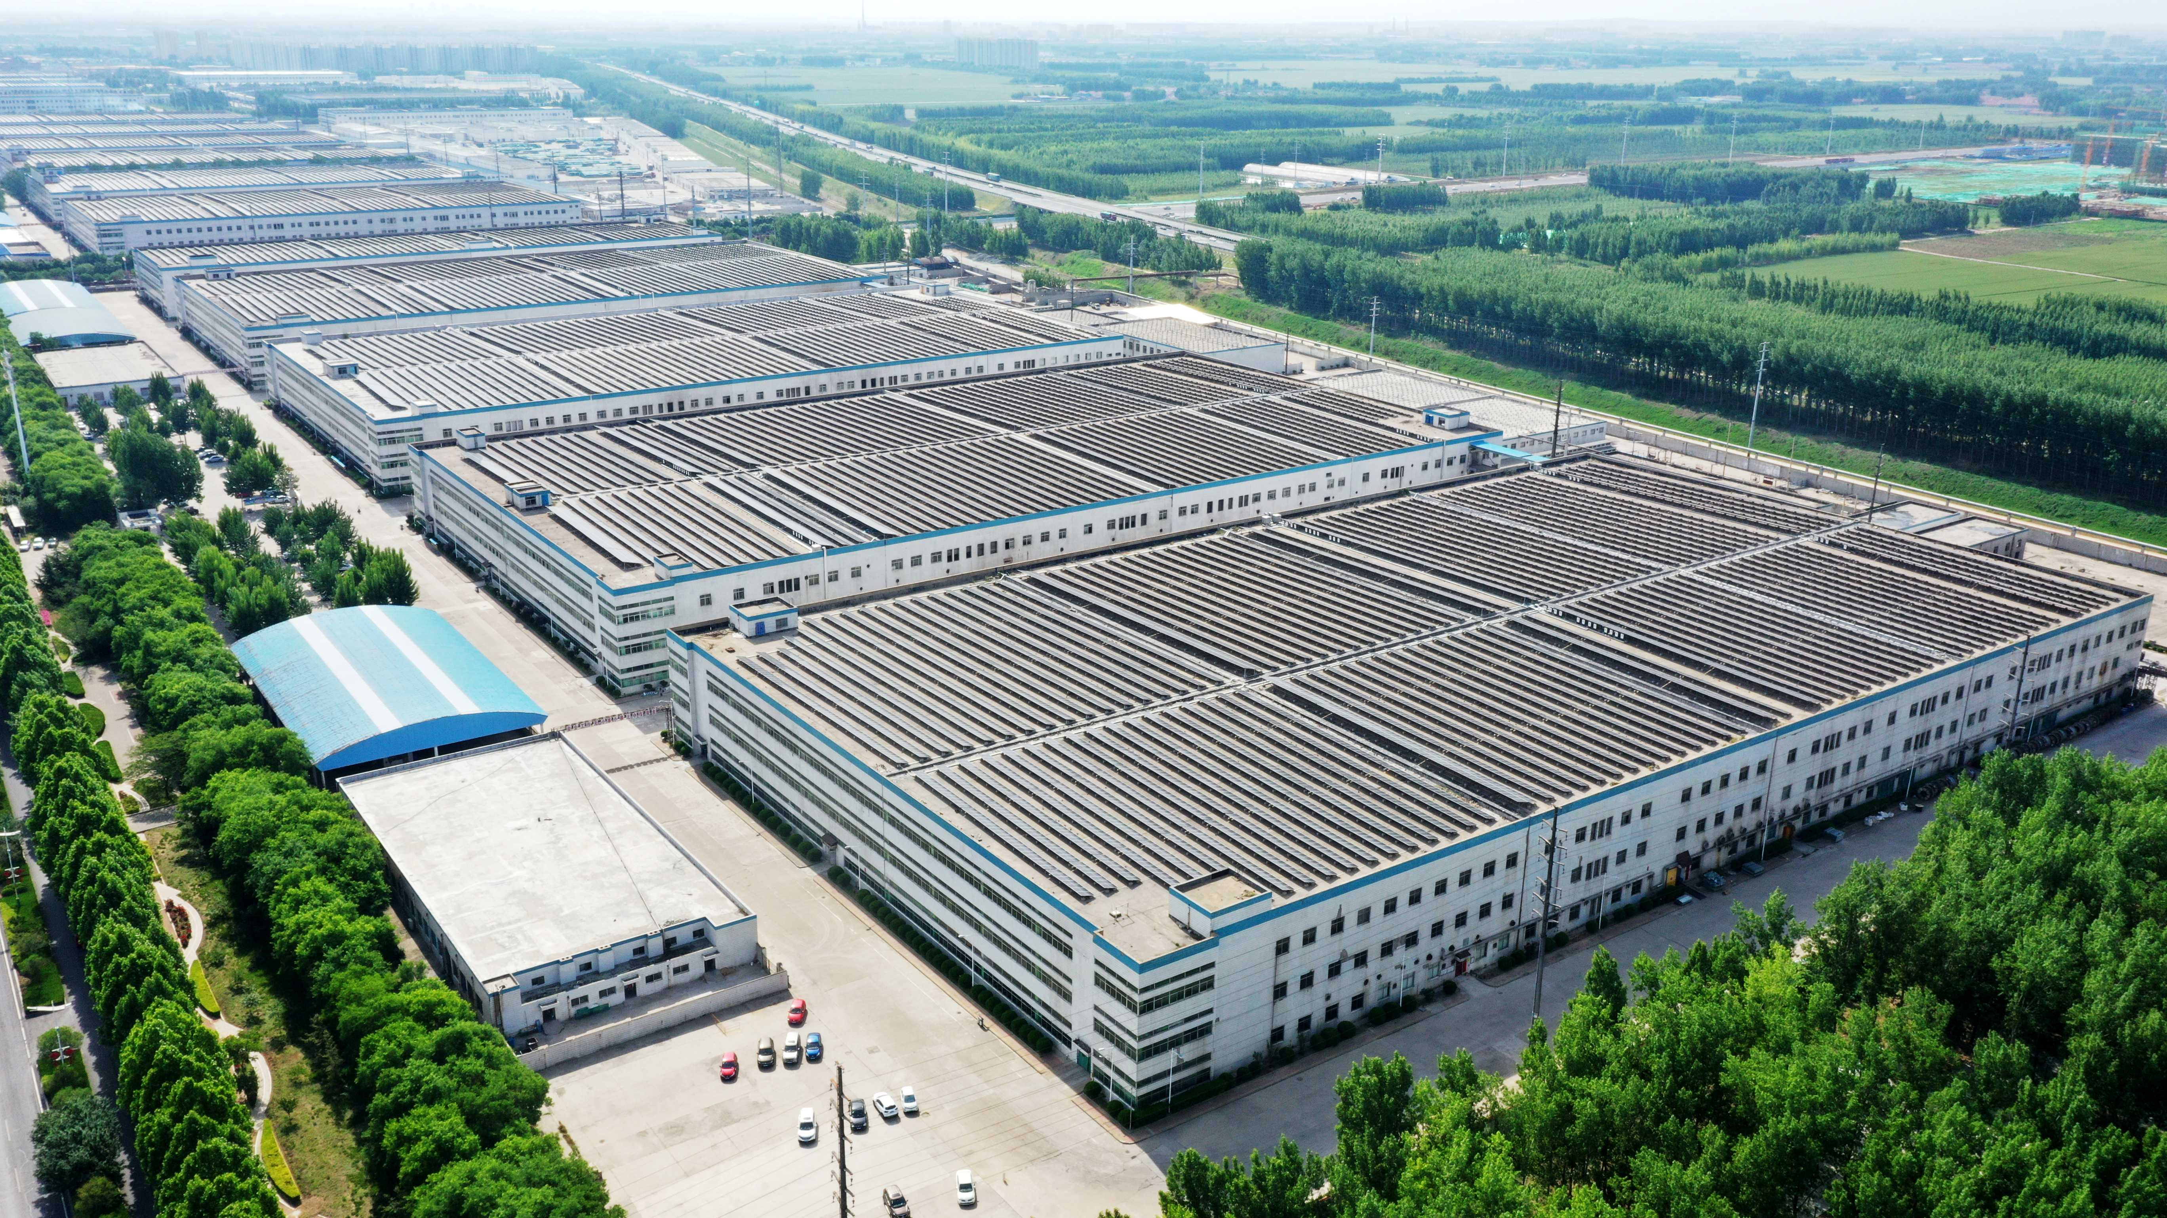
Rooftop PV Installation 安装的屋顶光伏

Slide 23
New Energy Structure Accelerates 新能源结构加速发展
Binzhou coastal area in Shandong 2 GW PV under construction, further optimizing our energy structure and enhancing core competitiveness
山东滨州沿海区域2GW光伏项目在建，进一步优化能源结构，增强核心竞争力
new development approval for additional 3 GW solar & 210 MW wind in Shandong
山东已获批另外的3GW太阳能和210MW风能的新项目

Slide 24
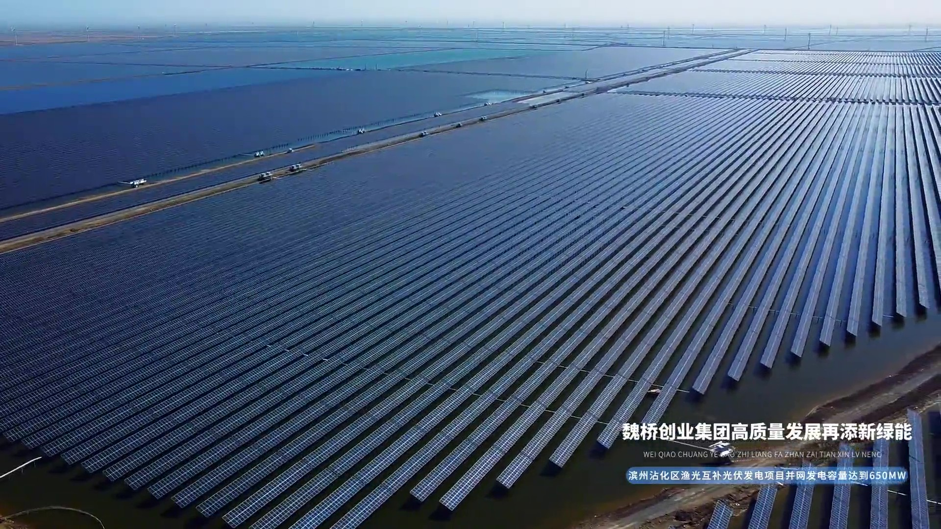

Slide 25
China Hongqiao 2024 Carbon Reduction Action Report
中国宏桥2024减碳行动报告
Total Scope 1 & 2 Emissions 2020: 101.4 Mt CO₂e
2020年范围1&2总排放：1.014亿吨CO₂e
Total Scope 1 & 2 Emissions 2024: 95.6 Mt CO₂e
2024年范围1&2总排放：0.956亿吨CO₂e
. . . . recording a 5.8% reduction, BUT a 23.8% emission intensity reduction for electrolytic aluminium from 2020 to 2024
表示降低了5.8%，但2020至2024年电解铝排放强度降低了23.8%
the result of a combination of different factors pulling in different directions, such as increased production and major construction activities across the Group
不同因素相互作用的结果，例如整个集团的产量增加和主要建设活动

Slide 26
Emission Intensity Reduction For Electrolytic Aluminium
电解铝的排放强度降低
2020 13.56 tonnes CO₂e
2021 12.16 tonnes CO₂e
2022 11.54 tonnes CO₂e
2023 10.85 tonnes CO₂e
2024 10.33 tonnes CO₂e
emission intensity will fall as our energy transformation continues, with capacity relocation and increased renewable energy becoming available.
随着我们能源转型的继续，产能转移和更多可再生能源变得可用，排放强度将下降。

Slide 27
China Hongqiao Molten salt energy storage pilot project
中国宏桥熔盐储能试点项目
Pilot project to facilitate new energy consumption, energy saving, emission reduction
促进新能源消费、节能减排的试点项目
500MW capacity electric heater to guarantee 6 hours continuous operation and 24-hour high-pressure steam supply
500MW容量的电加热装置，保证6小时连续运行和24小时高压蒸汽供应
leveraging advantages of high-temperature molten salt energy storage with its large heat storage temperature difference, high heat storage density, good heat transfer performance, stable working status, and low cost
利用高温熔盐储能的优势：储热温差大、储热密度高、传热性能好、工作状态稳定、成本低

Slide 28
Binzhou-Zouping Innovative Industrial Segments
滨州-邹平创新产业板块
Moving Zouping downstream as midstream moves to Yunnan
当中游产业向云南转移时，邹平向下游产业转移
new investments focused on automotive lightweight design and prototype development, component production, with future expansion into rail and aerospace
新的投资集中在汽车轻量化设计和原型开发，零部件生产，未来将扩展到铁路和航空航天领域

Slide 29
Weiqiao New Energy Vehicles (NEV) driving towards sustainability 魏桥新能源汽车（NEV）推动可持续发展
A new Shandong aluminum cluster development
一个新的山东铝产业集群的发展
combining lightweighting center, vehicle component production, R&D, vehicle dismantling and recycling to build efficiency via co-location of existing and new activities
将轻量化中心、汽车零部件生产、研发、汽车拆解和回收结合起来，通过聚集现有和新活动在一起来提高效率

Slide 30
China Hongqiao - Investing in the Future
中国宏桥——投资未来
      Strengthening China’s research capabilities via co-operative research projects with universities and national research institutions
      通过与大学和国家研究机构的合作研究项目，加强中国的研究能力
      Weiqiao-University of the Chinese Academy of Sciences in Binzhou for advanced industrial research
      滨州的魏桥和中国科学院大学进行先进工业研究

Slide 31
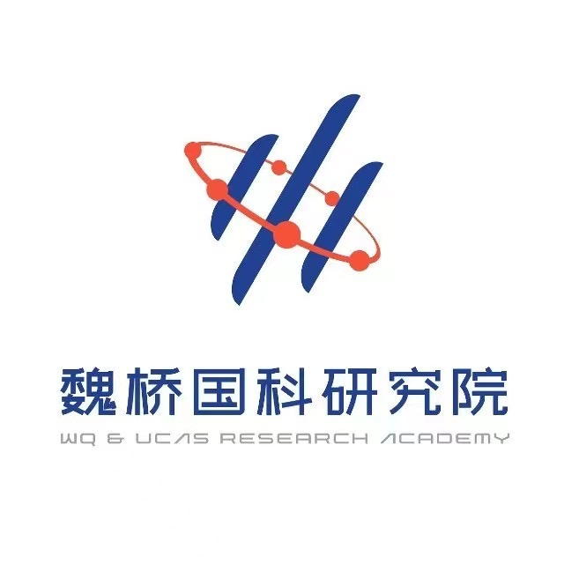
Weiqiao & UCAS Research Academy
魏桥国科研究院
      A platform for integration of science, education, innovation, and production
      科教创产融合平台
      accelerate high-quality development
      加快高质量发展
      linking technological and commercial worlds
      连接技术和商业世界

Slide 32
China Hongqiao Ongoing Agenda 中国宏桥持续的议程
Maintain core cluster advantages 保持核心的集群优势
renewable energy & operational efficiency to complement energy transition
用可再生能源&运行效率来补充能源转移
R&D, innovation driving aluminum advancement 研发和创新引领铝程发展
accelerate scientific & technology adoption 加速科技应用
strengthen talent pool & development opportunities 强化人才库和发展机遇
uphold the core value of “serving the country and benefiting the people”.
坚持“为国创业，为民造福”的核心价值观。

Slide 33

Thank you!

